Slide 2

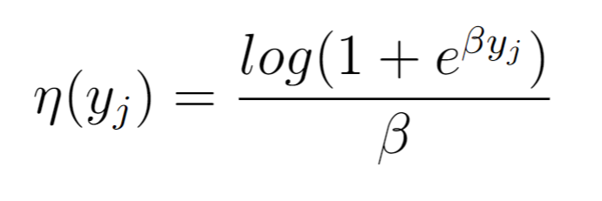

Forward model in 3 easy steps
1- Linear weighted inputs
2- Softplus output nonlinearity
3- Gain and threshold

Slide 3


Maximizing mutual information

Slide 4

Firing rate constraint – Lagrange multipliers

Slide 5





Example RFs
However, colors can be misleading!
Solution: Radial averages

Slide 6
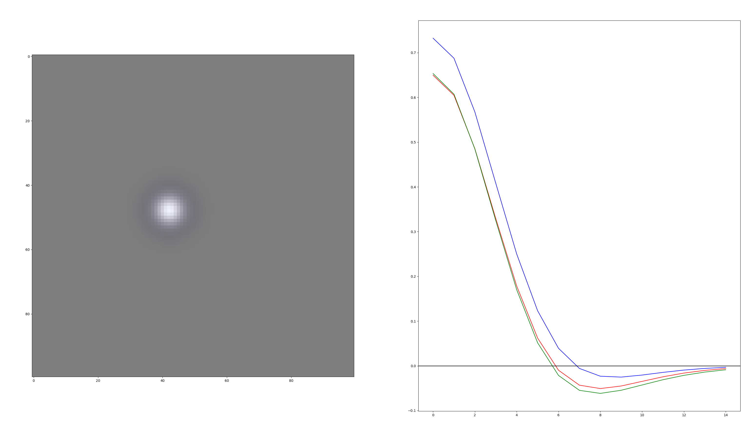

Slide 7
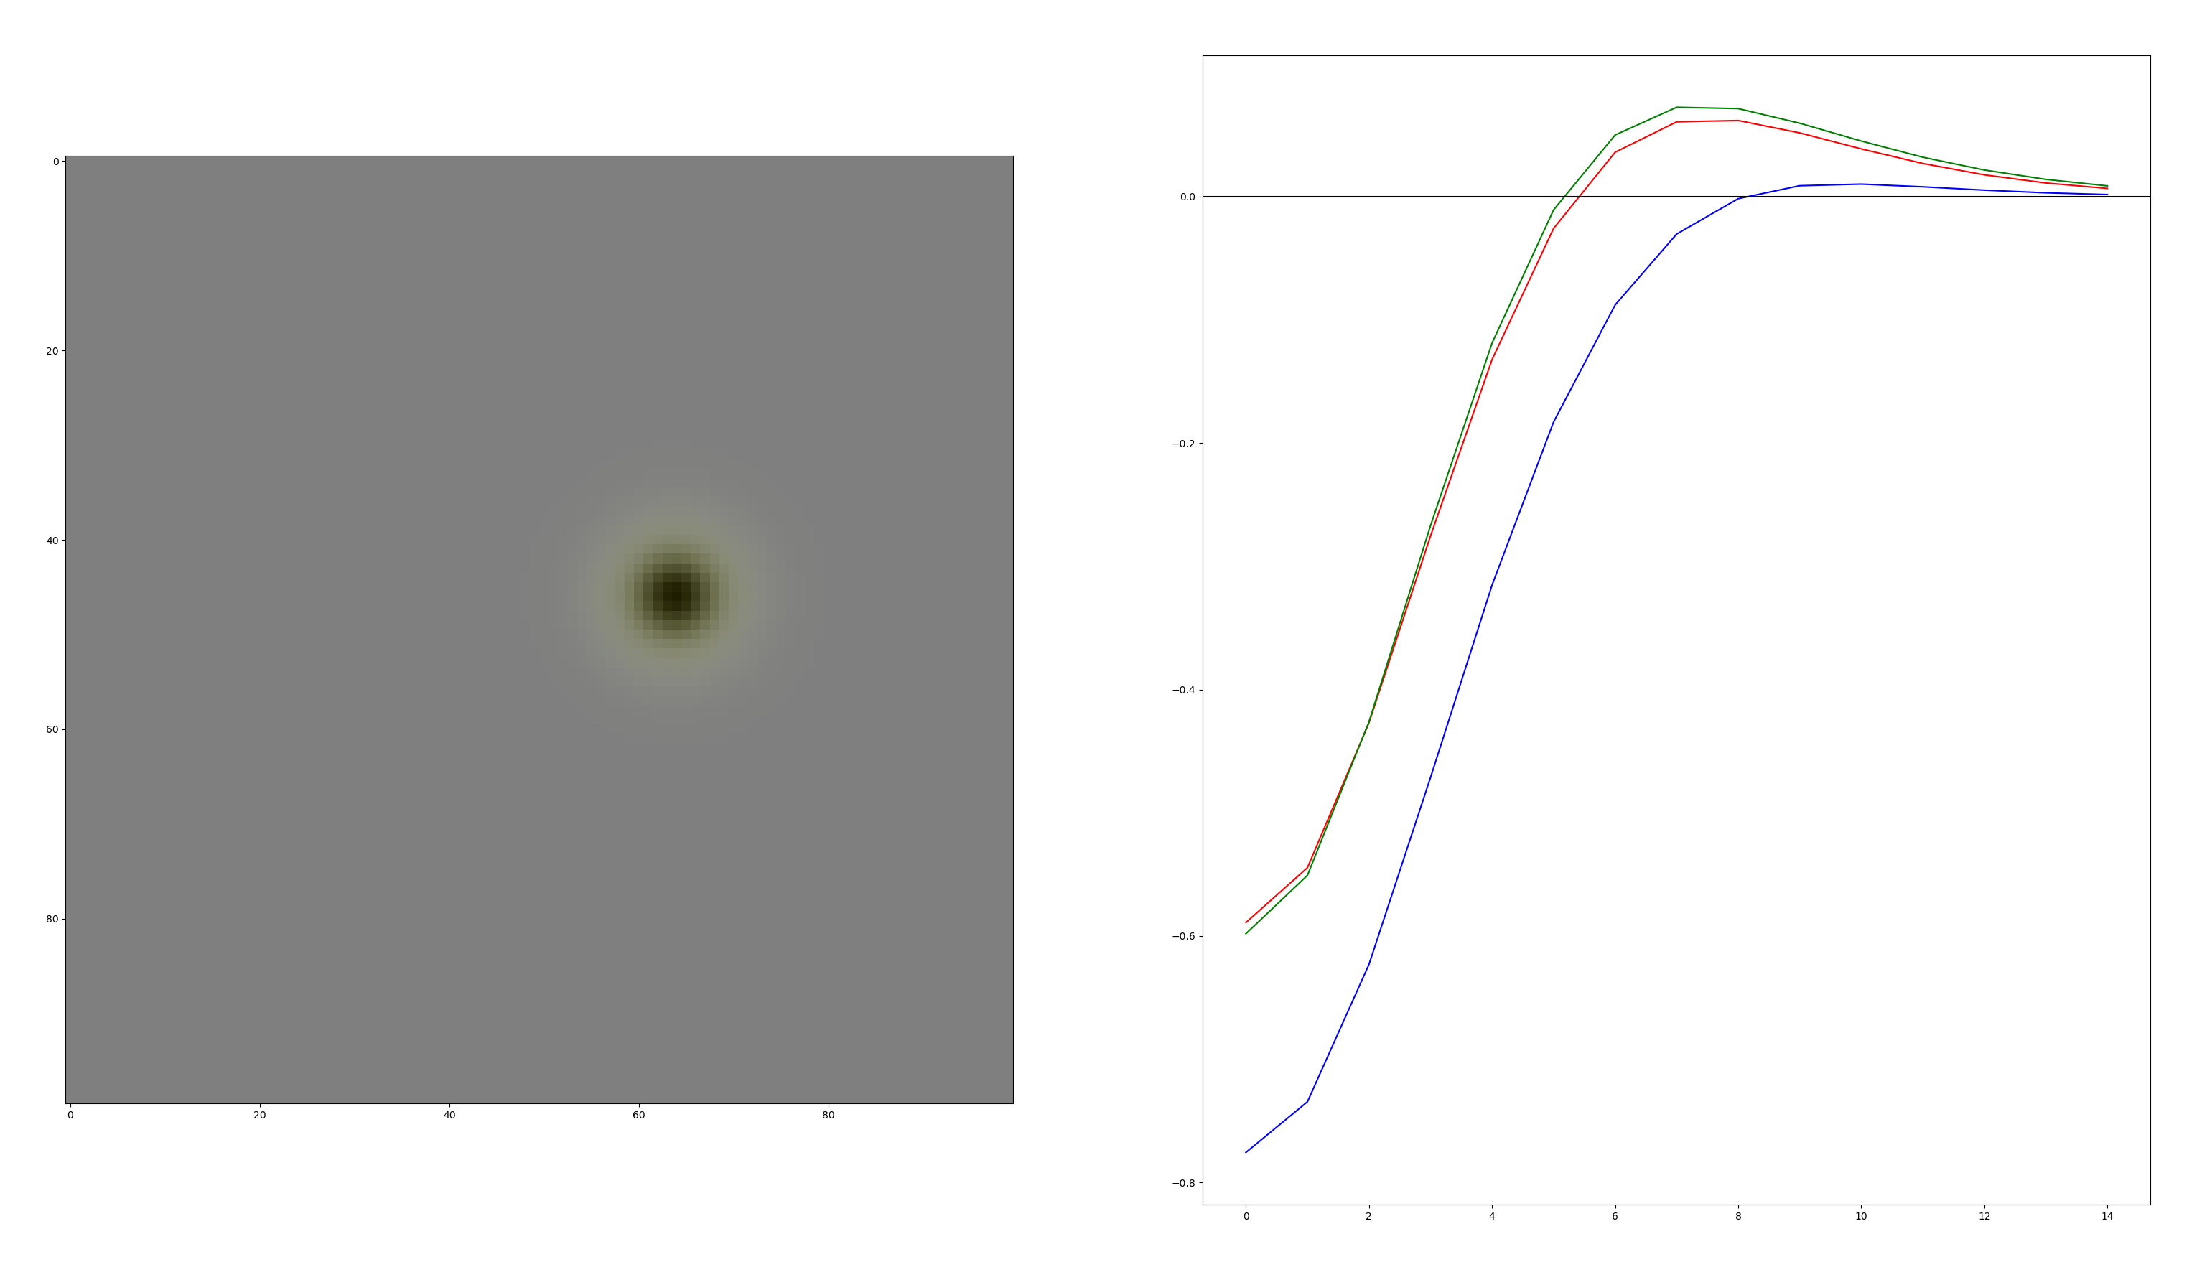

Slide 8
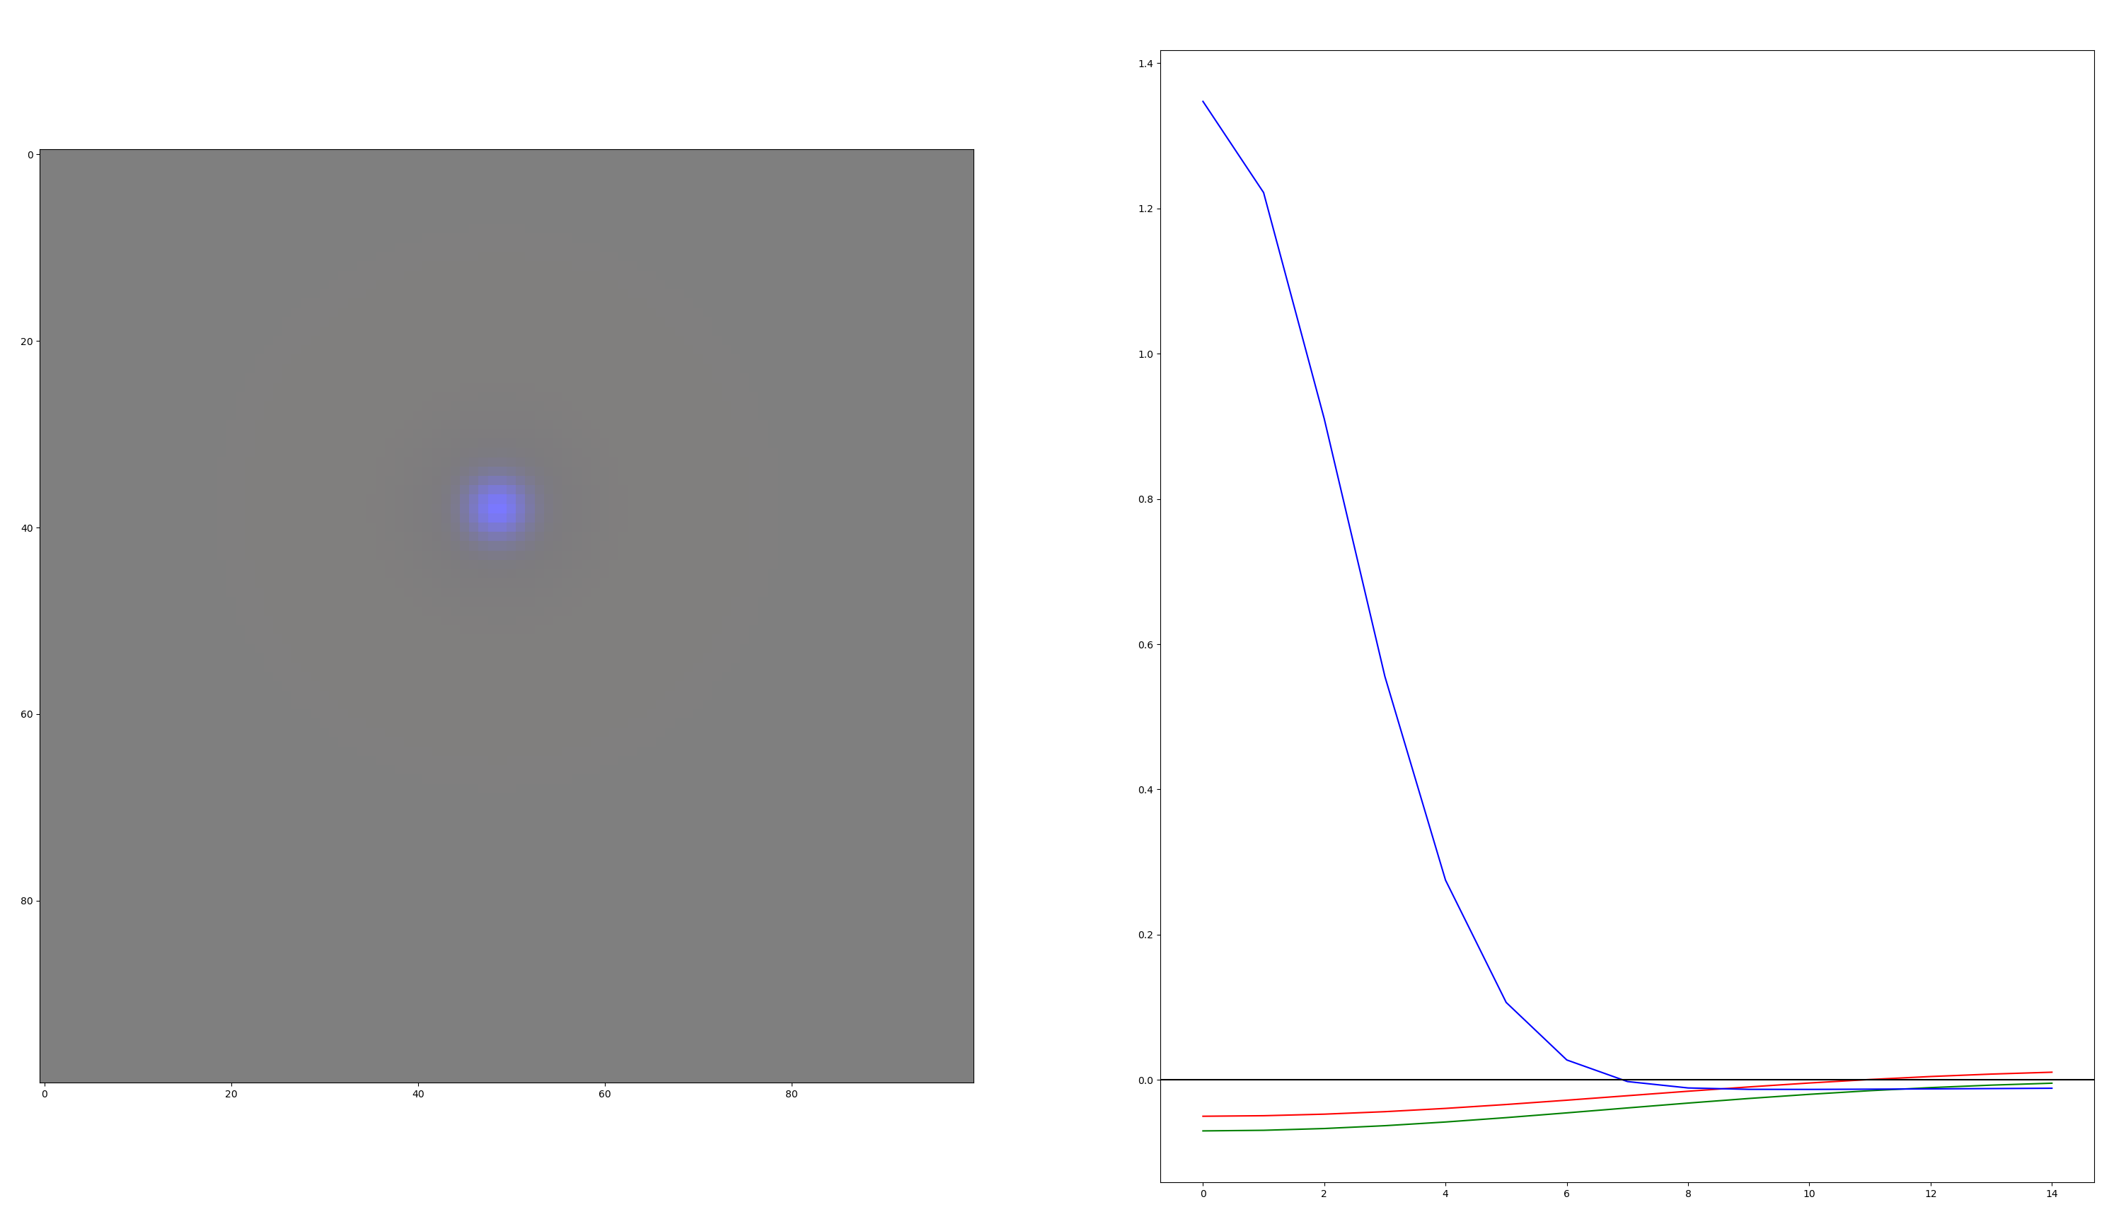

Slide 9
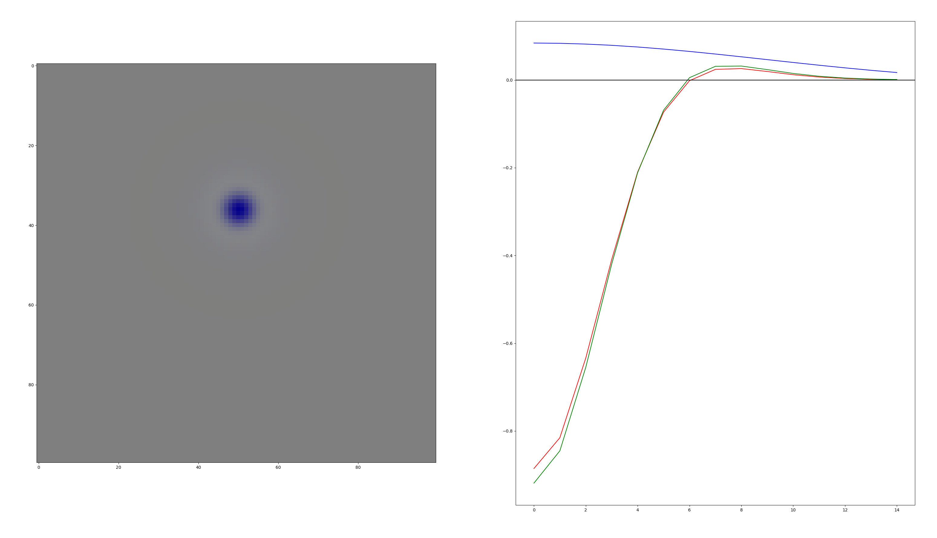

Slide 10
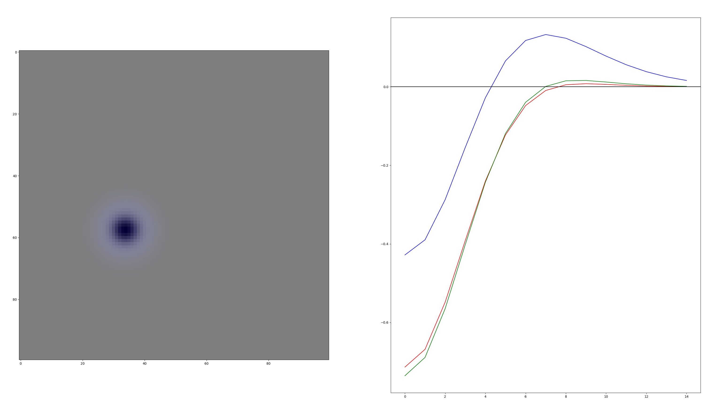

Slide 11
